Slide 1
Prime Numbers and Cicada Cycles
By David Dadiomov, Yaqun Deng, and Brendon Hahm

Slide 2
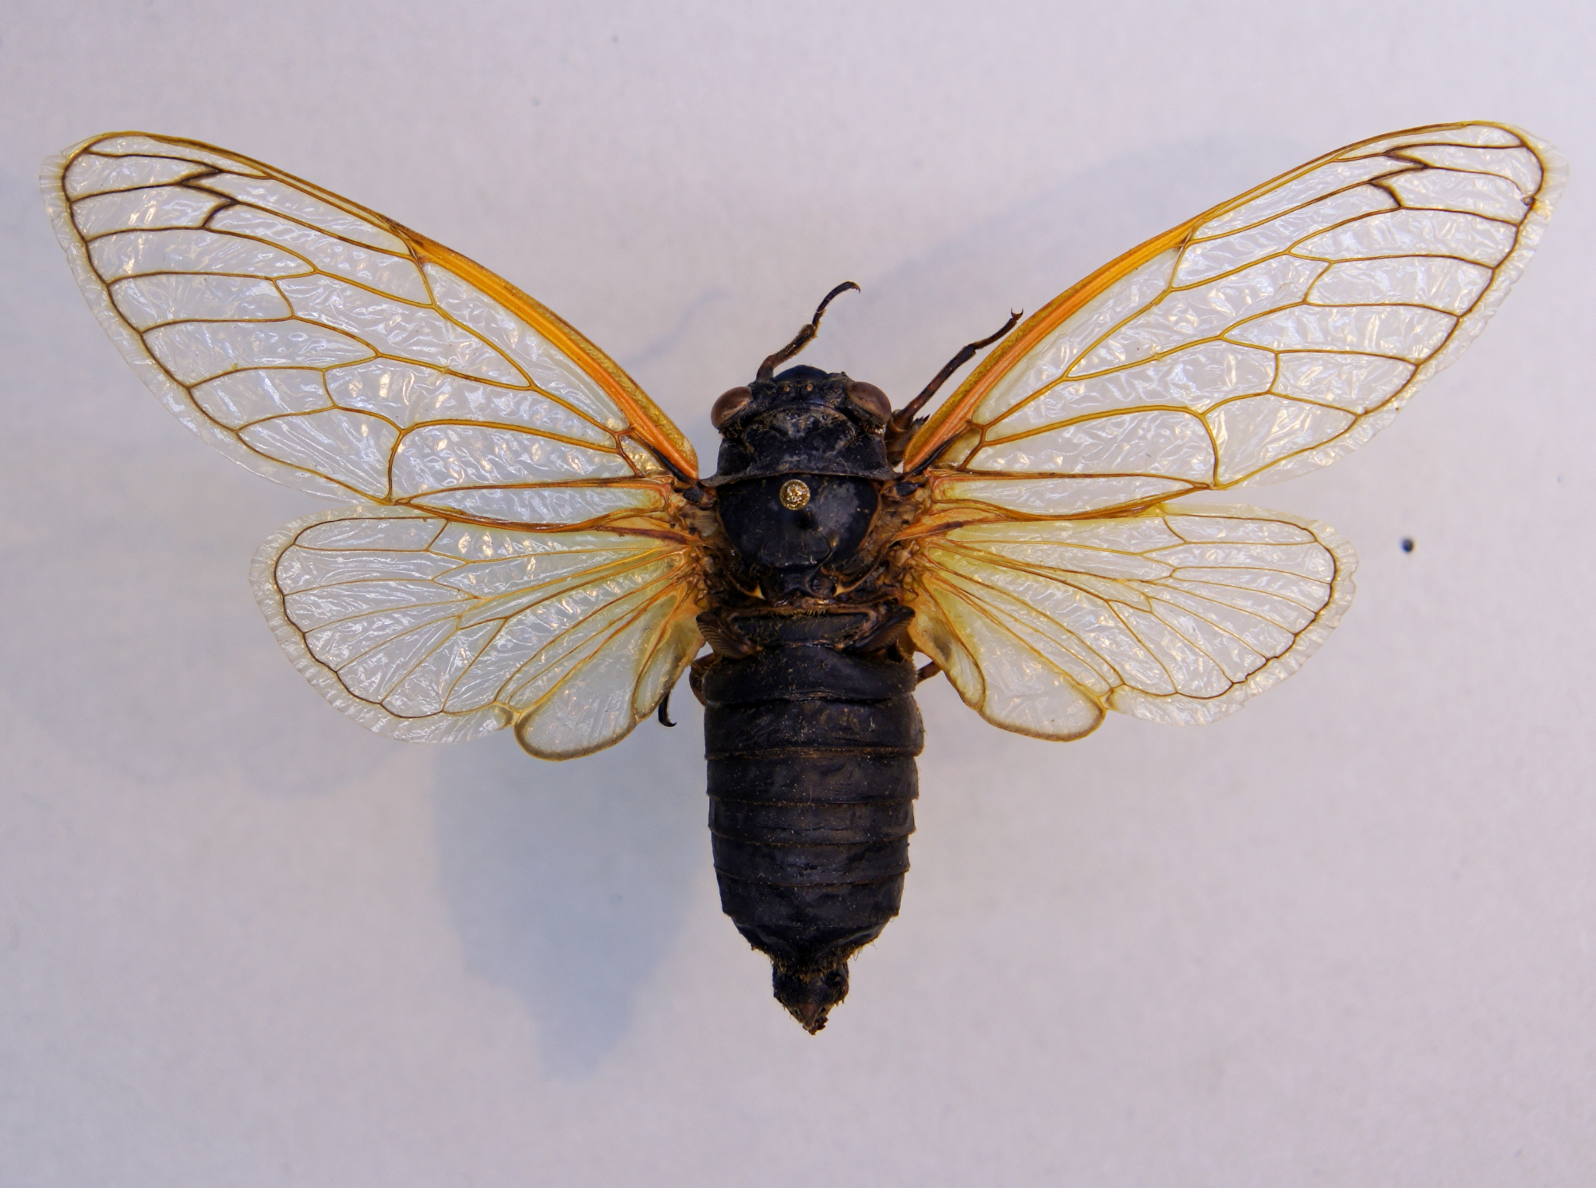
Background on Cicada Cycles
The life cycle of magicicada is either 13 years or 17 years depending on the subspecies
They spend their entire lives underground only to emerge on the final year for a short period to mate
These periodical cicadas have no consistent predators
This periodical behavior is unique to eastern north american cicadas
Image Above: Magicicada

Slide 3
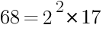
Background on Prime Numbers
Prime numbers have the unique quality of being indivisible by other numbers (other than one)
All composite numbers have a prime factorization that can reduce the number to a formula of exponentiated prime terms multiplied with each other
Prime factorization has many applications, particularly of note in calculating the least common multiple (LCM) and greatest common divisor (GCD) of two numbers
Ex: Prime Factorization of 68

Slide 4
Questions and Points to Consider for Survival
Are there optimal periods of emergence that maximize cicada reproduction and minimize predatory threats?
Predators are more active at the end of their reproductive cycles (when reproduction is to occur) due to higher nutritional demands for reproduction and offspring
Their periodical behavior restricts reproduction to only 0.5% of their life cycle
How is this beneficial for survival?
How do life cycles and predatory threats relate to prime numbers?

Slide 5
The Link between Primes and Periodical Cicadas
Both 13 and 17 are prime numbers and it is hypothesized, and largely accepted in the literature, that these prime numbered cycles are the result of an evolutionarily advantageous survival strategy
Reminder: Periodical Cicadas only emerge on their final year in the cycle to reproduce and are only exposed to predatory threats during their emergence
The least optimal emergences are the years that both periodical cicadas emerge and the end of predators’ reproductive cycles
Therefore, periodical cicadas’ life cycles will adapt to minimize these concurrent years
Concurrent years are determined by multiple of both (since they are cyclical)
LCMs give us a way to understand the frequency of concurrent years and maximization of LCM leads to the lowest frequencies of concurrent years

Slide 6
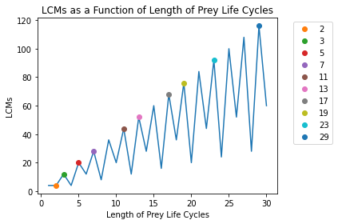
Predator Simulation: Predator with 4 Year Cycle
Predator reproductive cycle is fixed at 4 years
Prime numbers are labeled and marked

Slide 7
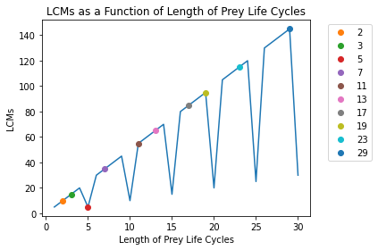
Predator Simulation: Predator with 5 Year Cycle
Predator reproductive cycle is fixed at 5 years
Prime numbers are labeled and marked

Slide 8
Predator Simulation: Predator with 6 Year Cycle
Predator reproductive cycle is fixed at 6 years
Prime numbers are labeled and marked

Slide 9
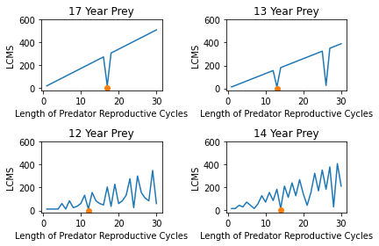
Predator Simulation: Different Life Cycles
Orange markers indicate when predator reproductive cycle = prey life cycle
We can see that for almost all ranges, prime numbered prey life cycles provide higher LCMs across varying lengths of predator reproductive cycles
Top Row: Prime numbered prey life cycles
Bottom Row: Non-prime numbered prey life cycles

Slide 10
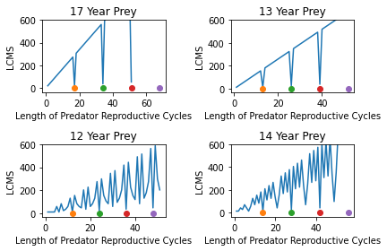
Coprime Cycle Lengths
Same visualization but the range of predator reproductive cycles is 52
We see that every major trough (marked with dots) is when predator reproductive cycle is multiple of the prey’s years
For the prime numbered years, we notice that these numbers are only when the predator reproductive cycle is not coprime with the cicada’s life cycle
Note: This is when GCD =/= 1

Slide 11
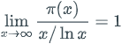
Prime Number Theorem
Let π(x) be the number of prime numbers in the range from 2 through x. Then
Another way to interpret the Prime Number Theorem is that if a random number is selected from the range 2 through x, then the likelihood that the selected number is prime is roughly 1/ln(x)

Slide 12
Applications of Prime Number Theorem
According to the Prime Number Theorem, the probability that the selected number is prime from year 1950 to 2021:
1 / ln(70) = 23.54%
In fact, for species M. septendecim, M. cassini, and M. septendecula, the years they emerge from 1950 till now were 1953, 1970, 1987, 2004, 2021 (Cicada Mania, 2021). The probability of emerging is:
5 / 71 = 7.04%

Slide 13
GCD and LCM
The greatest common divisor (gcd) of integers x and y that are not both zero is the largest positive integer that is a factor of both x and y.
The least common multiple (lcm) of non-zero integers x and y is the smallest positive integer that is an integer multiple of both x and y.
GCD Theorem: Let x and y be two positive integers such that x ≠ 0. Then
gcd(x, y) = gcd(y mod x, x)

Slide 14
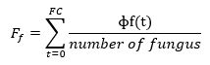
Momentary Fitness
We assume:
a fungus (predator) of period F interacting with a cicada of period C
A momentary fitness Φ_{c}(t) of the cicadas in a year t:
If both fungi and cicadas are present: Φ_{c}(t) = -1
If cicadas are present but the fungi are not: Φ_{c}(t) = +1
If cicadas are not present: Φ_{c}(t) = 0
The fitness Ff, resp. Fc is defined by the sum over the Φf(t), resp. Φc(t), t = 0, …, FC, divided by the number of fungus, resp. cicada generations (Markus, M., & Goles, E., 2002).

Slide 15
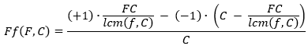
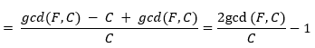
Applications of GCD and LCM
In FC years, the fungi appear C times, both cicadas and fungi appear FC/lcm(F,C) times, fungi without prey appear C- FC/Icm(F,C) times (Markus, M., & Goles, E., 2002)
gcd(F, C) * lcm(F, C) = FC:
fungus fitness
For the same reason, cicada fitness Fc(F, C ) = 1 - 2gcd(F, C)/F

Slide 16
Stability of Prime Prey Cycles
Assume C = Cp is a prime; by virtue of condition K, any F is relatively prime to Cp
Therefore gcd(F, Cp) = 1, so that starting from (F, Cp), there exists no fungus mutant that are fitter than a resident fungus (Markus, M., & Goles, E., 2002)

Slide 17
Importance
Intrinsic link between primes and periodical cicadas
A genuine example of mathematics in the real world (Baker, 2005)
Strikingly direct application of number theory to real world phenomena

Slide 18
Citations
Prime numbers, cicadas, online classes: How a lecturer brought them together in IIT-Bombay. (2021). Down to Earth (New Delhi, India).
Markus, M., & Goles, E. (2002). Cicadas showing up after a prime number of years. The Mathematical Intelligencer, 24(2), 30–32. https://doi.org/10.1007/BF03024615
Milius, S. (2013, July 13). Mystery in synchrony: Cicadas' odd life cycle poses evolutionary conundrums. Science News, 184(1), 26+. https://link.gale.com/apps/doc/A336941697/ITOF?u=mlin_b_northest&sid=bookmark- ITOF&xid=bb2bc698
Baker, Alan. “Are There Genuine Mathematical Explanations of Physical Phenomena?” Mind, vol. 114, no. 454, 2005, pp. 223–238., https://doi.org/10.1093/mind/fzi223.
Visualization Code: https://colab.research.google.com/drive/1FChikqff1alkO2262X15nqtOtPrLcnvj?usp=sharing

